Slide 1

How Brazil was affected by hosting
the 2016 Summer Olympics

Slide 2
Olympics 2016 impact on Brazil. Analysis from different perspectives
National Pride: Number of Medals
International Trade
Economic Health: GDP, Inflation and CPI, debt
Society: crime rates
Wellbeing for citizens: Happiness Rankings

Slide 3
National Pride: Number of Medals
Assumption
We assume that Athletes of hosting country have more familiarity with home field, receive greater support from home crowd, have easier qualification criteria, thus more participation is anticipated.
Considering all these factors we are expecting increase in number of Medals Brazil won in Rio 2016 comparing to the number of medals Brazil usually wins.
How hosting the Olympics impacted number of total medals and gold medals Brazil won that year.

Slide 4

Data Source
Dataset on the modern Olympic Games, including all the Games from Athens 1896 to Rio 2016.
https://www.kaggle.com/heesoo37/120-years-of-olympic-history-athletes-and-results?select=noc_regions.csv
This dataset was scraped from www.sports-reference.com in May 2018.
The csv file contains 271116 rows and 15 columns. Each row corresponds to an individual athlete competing in an individual Olympic event.
World Bank's data API to get GDP data.
WBGAPI python package to work with data was installed and used.
https://pypi.org/project/wbgapi/
pip install wbgapi.

Slide 5
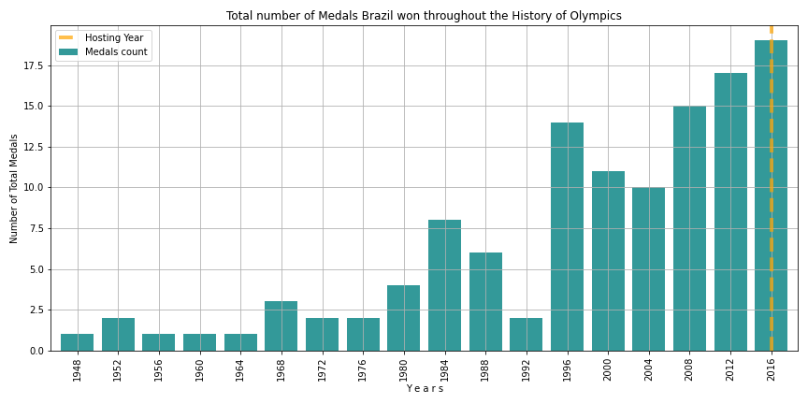
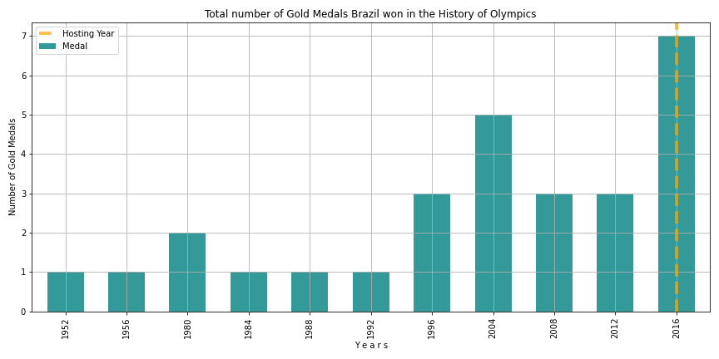
Total and Gold number of Medals Brazil won throughout the history of Olympics.
Hosting Year 2016:
Total number of Medals is higher than in any other previous games: 19 medals total.
The average for years with highest Medal Count (1996-2012) is 14.3;
The average for all other years (<1996) is 2.75 total medals.
Total number of Gold Medals is higher than in any other previous games: 7 gold medals.
The next highest number is 5 Gold Medals in 2004;
For all other games the average number is 1.7 gold medals.

Slide 6
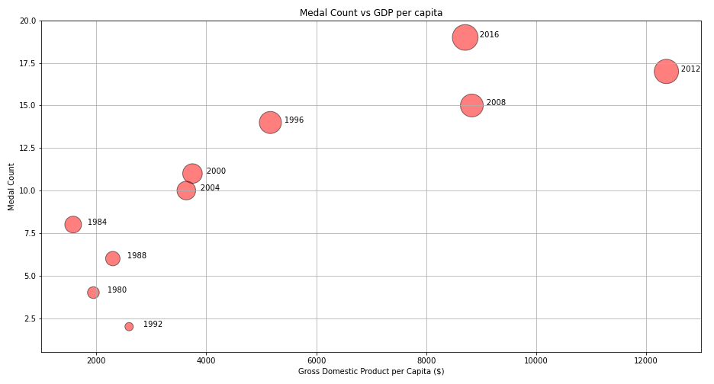
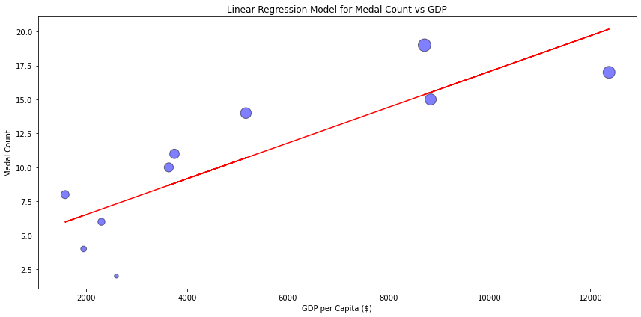
Investigating correlation between Number of Medals and GDP
A possible factor of Medal Count increase could be the increase of GDP (or GDP per capita)
Relationship between Total Medals vs GDP per capita and Linear Regression Model.
Linear Regression Model and R-value = 0.85 shows that there is a strong correlation between GDP per capita and Medals Count.
However, the GDP itself does not explain the highest number of Medals in 2016.

Slide 7
Conclusion
Our findings show that Brazil won its highest number of total and gold medals in the year of hosting the Olympics.
Linear Regression Model for Number of Medals and GDP over Olympics years revealed that there is a strong correlation between Number of Medals and GDP per capita.
However, GDP level in 2016 does not explain the highest Number of Medals Brazil won that year.
Thus, we can conclude that it's hosting the Olympics that caused Brazil to win more medals this year than in any other year before.

Slide 8
International Trade
Assumption
While bidding to host the Olympics, it is implied that country reduces restrictions on the international exchange of goods.
We are assuming that such strategy should lead to considerable positive change in Brazil international trade.
How hosting the Olympics impacted Brazil international trade.

Slide 9



Data Source
World Integrated Trade Solution (WITS) API to get Trade Data.
In partnerships with
UNCTAD (United Nations Conference on Trade and Development);
World Bank;
WTO OMC.
Python package to work with WITS API
https://pypi.org/project/world-trade-data/
pip install world_trade_data

Slide 10
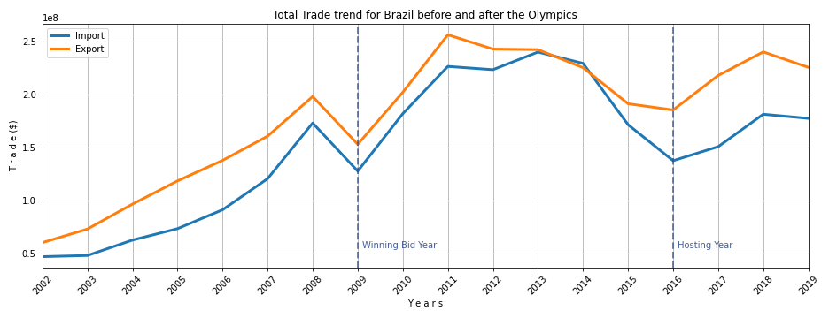
Yearly Export and Import Trend for Brazil.
Time period: from years preceding the year Brazil won the bid to host games to the most recent year with trade data available from WITS after hosting Olympics.
Trend tendency over time shows increase in Trade after year of winning the bid to host Olympics - 2009.

Slide 11
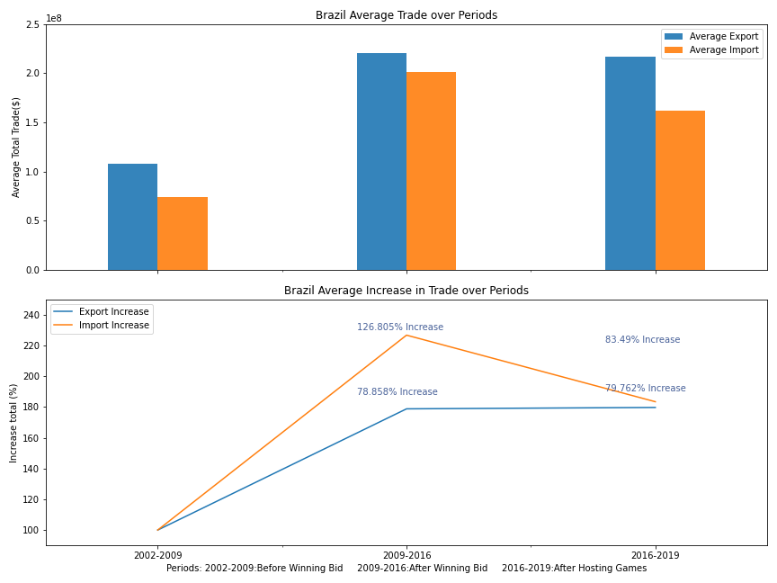
Investigate Trade Growth
Average Trade values were calculated to estimate the average increase in Trade:
In the period 2009-2016 Import increased by 126.8%, Export by 78.9% in comparison to 2002-2009.
In the period 2016-2019 Trade stays at the obtained increased levels: Import increased by 83.5%, Export by 79.8% comparing to the average Trade values before 2009.

Slide 12
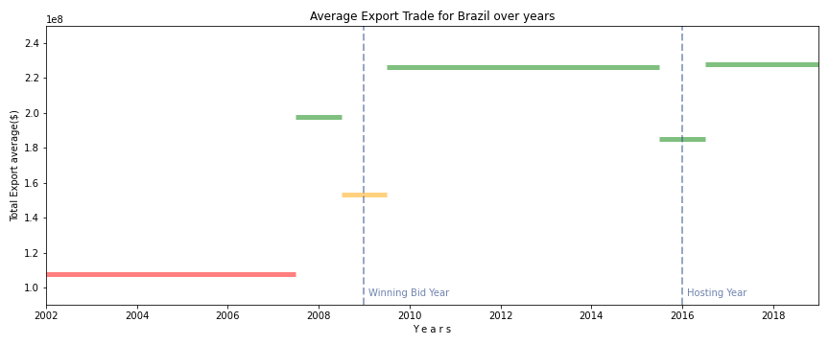
Average Export Trade over time including separate years
Chart shows in more details how hosting Olympics affects Export trade.
The year before winning the bid 2008 it jumps up, winning the bid year 2009 - goes down.
Significant permanent trade increase comparing to trade level before 2008 is seen after winning the bid.
Trade goes a little down at the year of hosting 2016 and stays at the obtained high level after hosting the Olympics.

Slide 13
Conclusion
From the available data we can see that Brazil experienced Trade Growth after hosting the Olympics.
To be more precise, Trade Growth starts from the time when Brazil was on the verge of winning the bid to host the Olympics - year 2008.
Average change in trade by periods shows Trade increase in 2009-2016 comparing to previous years and stays at the same high level after 2016.
It is not obvious from our analysis though what would happen to Trade tendency without actual hosting the Olympics. It might be that just bidding to host Olympics is enough for country to experience significant and permanent growth in Trade.

